Slide 1


SAP UI5 & FIORI with OData TRAINING using BAS
Anubhav Oberoy
Day – 4

Slide 2

Agenda – Day 4
Hook Functions
Control Hierarchy
Models in SAP UI5
Model Basics
Steps to Create a Model
Data Binding
Types of Data Binding Syntax
Types of Binding
Modularization of model
Binding Modes.
Expression Binding
Concept of Named Model
How to create Named Model
Aggregation Binding

Slide 3
Hook Method of Controller
onInit()
onBeforeRendering()
It is a function which gets called immediately after UI5 creates the object of our controller. It is like constructure of a class. We can use this to initialize our class variable
It is a method which gets called MULTIPLE times, Before every time the view is displayed to the user. We can use this method for pre-processing on a view.
IN
BR
EX
AR
onExit()
onAfterRendering()
It is a function which gets called before the instance of our controller gets destroyed. It is like destructor of a class.
We can use this to write clean-up code.
It is a method which gets called MULTIPLE times, After every time the view is displayed to the user. This method can be used to show effects to the user.

Slide 4
Concept of Control Hierarchy
Concept of control Hierarchy tells us about how the SAP UI5 Controls are structure on the basis of the object oriented Paradigm.
Note:- Whenever we see a control, and if we are unable to find a property, association, event or function in that class, check its parent class.
sap.ui.base.ManagedObject
sap.ui.core.Element
sap.ui.core.Control
sap.m.Button
sap.m.InputBase
sap.ui.view
sap.m.Table
sap.ui.layout.form
sap.m.Input
sap.m.Column
SimpleForm
Some Frequently used Controls

Slide 5
Basics of OOPS (Object Oriented Programing)
PASSENGER
+passport no +name +nationality
Walk(), talk(), print_boarding()
0..n
PLANE
+Airline +Width +Height
+fly(), +land(), #load()
ENGINE, WINGS
+capacity, +speed, +color
inheritance
PASSENGER PLANE
+no_of_seats
Load()
CARGO PLANE
+cargo_space
Load()
Association (relation between classes which are not of same group of family)
1. Aggregation – lose coupling, both objects can function independently, SHOULD have relation
2. Composition – tight coupling, both cannot function independently, MUST have relation

Slide 6
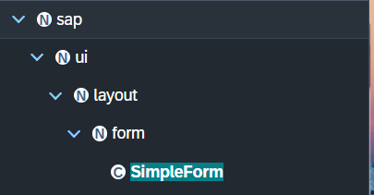
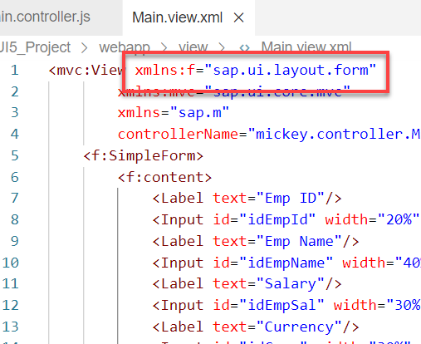
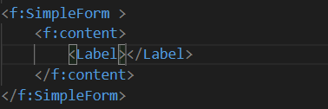
Basics of control hierarchy
To use any control , first we have to include controls’ parent class into the view
For example: To use the SimpleForm we have to include its parent class which is sap.ui.layout.form
The namespace have to given to the parent class
xmlns:f=“sap.ui.layout.form”
When we use the aggregation of any control same namespace will follow by the aggregation as parent.
The control name must start with capital letter and the aggregation name starts with small letter.
We have to check which control will aggregate to the control itself, if the aggregate control is the Control class or element class we can pass any of their child class to the aggregation.
for example:
As the <f:content> extend the element class we can use the <Label> which is also child of element class inside the <f:content>

Slide 7
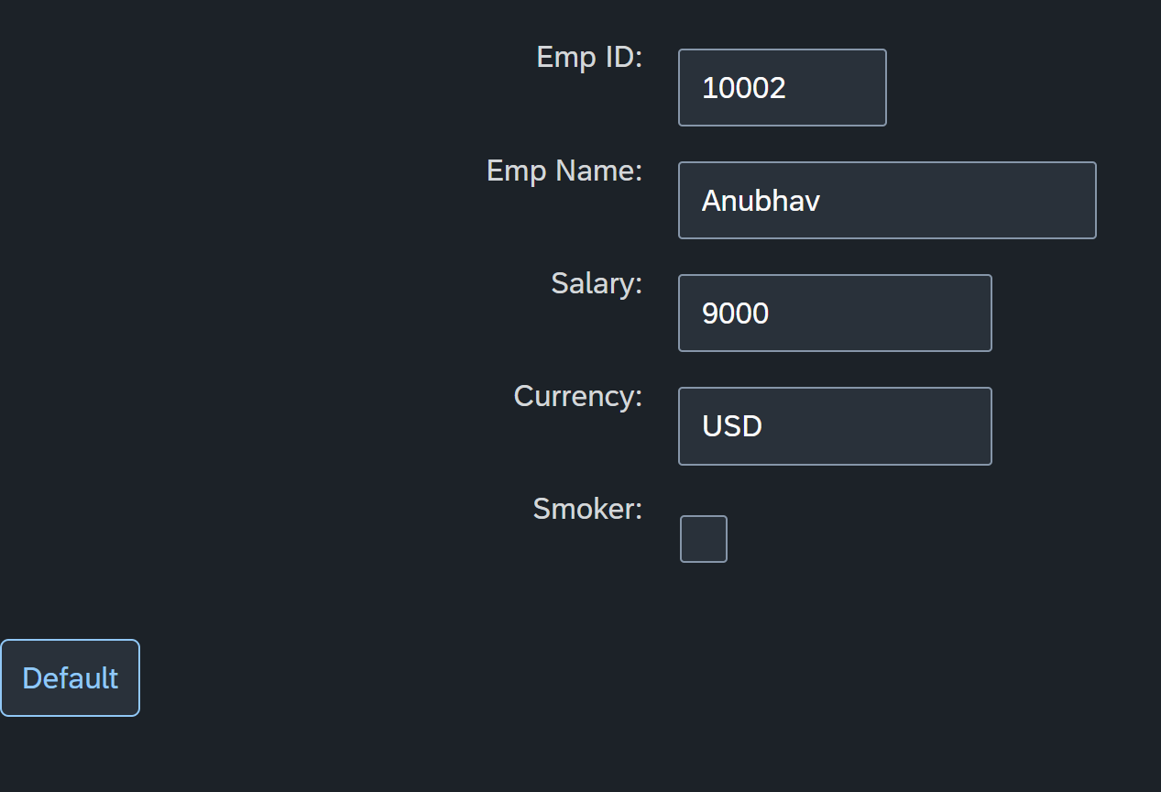
Hands – on: Simple Form Control
Now create a Simple form control in the View.
Along with that we will add a button below the Simple form and on press of that button change the value of one field in the Simple form.
Code Links:-
Main.view.xml
Main.controller.js

Slide 8
Model Basics
Models are object of data. All the models in SAP UI5 are characterized in two different parts:
Client-Side Model: -
Client Side Model are the models which keeps the data in the browser (client side), when app starts all the data will be loaded in one shot to the browser and kept there.
These models are used when the dataset is small and we want to manipulate data locally.
E.g. why we use internal table? – it’s a temporary store to manipulate the data and once we finalize we push data back.
Server-Side Model: -
Server Side Model are the models which keeps the data in the SAP system(server side), when app starts all the data will be loaded in one demand to the browser in a client side model from, server side model.
These models are used when the dataset is large and we want to fetch and store data back to SAP.
Imagine we have 20trillion records in our sap system, we cant access all data at once in mobile fiori app, so we use server side model to load it chunk by chunk.

Slide 9
Steps to Create a Model
There are 4 Easy Steps to Create a Model:
Step 1: Create a brand-new object of the Model
To Create JSON Model - var oModel = new sap.ui.model.json.JSONModel()
To create XML model – var oModel = new sap.ui.model.xml.XMLModel()
To create Resource model – var oModel = new sap.ui.model.resource.ResourceModel()
To create OData Model – var oModel = new sap.ui.model.odata.v2.ODataModel()
Step 2: Set or Load the data in the Model
oModel.setData({});
oModel.loadData(filePath);
Step 3: Make the model aware to the application/view
sap.ui.getCore().setModel(oModel) -- whole city knows where the gold is
this.getView().setModel(oModel) -- only the single view and its child control knows – only my family
this.getView().byId(“controlId”).setModel(oModel) -- one control have access to data – my dad
Step 4: Data Binding : It is the concept of mapping the Views and Model with which the UI knows where the data is into the model. This is done by calculating the path (address of the data).
Create object of the Model
Set/Load Data in Model
Set Model at View Level

Slide 10
Data Binding
Data binding is the process that establishes a connection between the application UI and business logic.
It is a bridge between a binding target(View) and a binding source(Model).
In the json data we can make address as “Every curly braces is converted to / and every array item is converted to /index”.
{"empStr": {
"empId": 0001,
"empName": "Anubhav",
"salary": 8000,
"currency": "USD"
},
"empTab": [{
"empId": 0009,
"empName": “Ananya",
"salary": 9500,
"currency": "USD“
}, {
"empId": 0010,
"empName": “Shwetha",
"salary": 10000,
"currency": “EUR"
}]}
Q: what is the salary of Anubhav
/empStr/salary
Q. What is the emp name of emp 0001
/empStr/empName
Q. What is the salary of Shwetha
/empTab/1/salary
Q. What is the empId of Ananya
/empTab/0/empId
This is the address of the data
To bind the data with the view we have to give the path of the data , so we have to use the curly braces as :
{/empStr/empName}
This is the path of the data

Slide 11
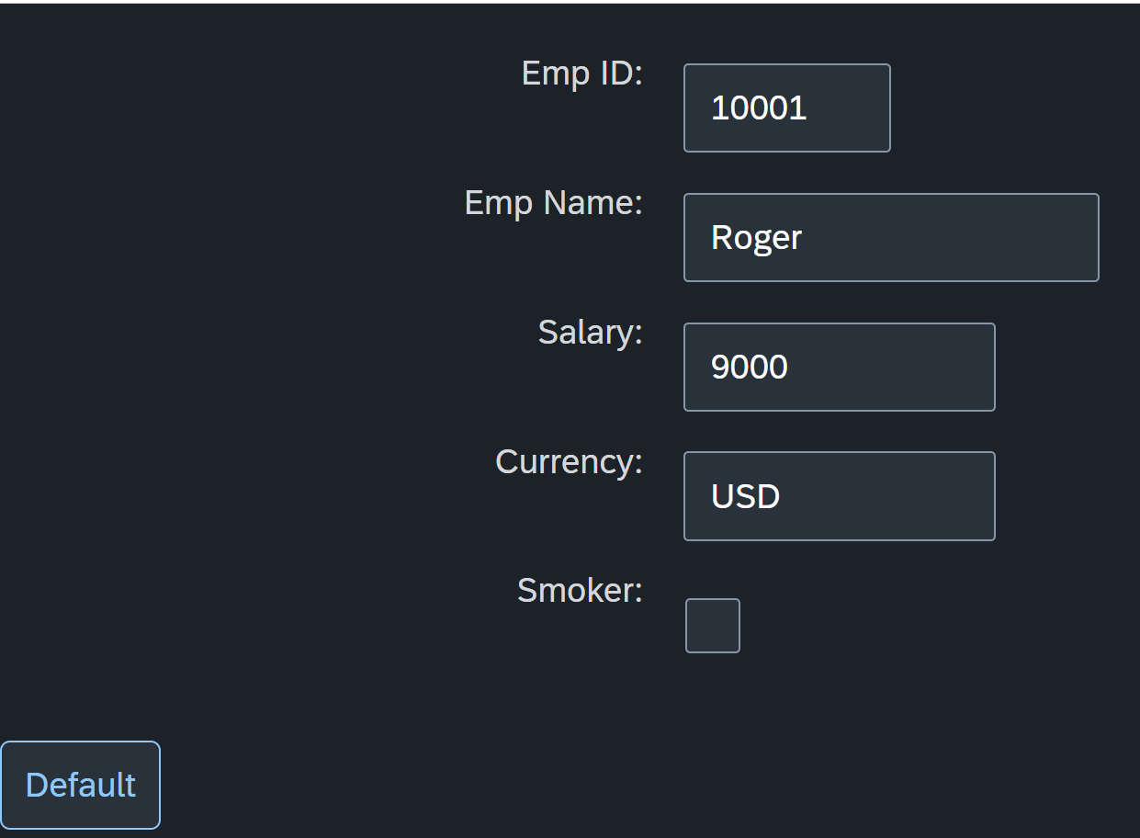
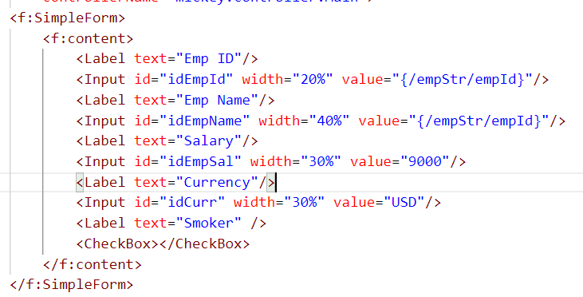
Hands – on: Create our first Model
Create a JSON model by following the steps explained in the previous Slides.
After Creating the Model bind the model to the SimpleForm using different binding Syntaxes.
Code links:-
Main.view.xml
Main.controller.js

Slide 12
Different Methods to Bind Property in View
Binding using the path of the data
{/empStr/empId}
Binding as property specific method:
this.getView().byId(‘controlId’).bindValue(‘/empStr/empSalary’)
Binding as property generic method:
this.getView().byId(‘controlId’).bindProperty(‘value’ , ‘/empStr/empSalary’ )
Binding using the path expression , this is also know as complex binding syntax
{path : ‘/empStr/empId’}
this syntax is helpful when we use formatter .
this syntax will not work by default until we inform it to the SAPUI5, to make this syntax work we have to add a line
code inside the bootstrap code of the application.
data-sap-ui-bindingSyntax= “complex”
Name of the property with which we want to bind

Slide 13
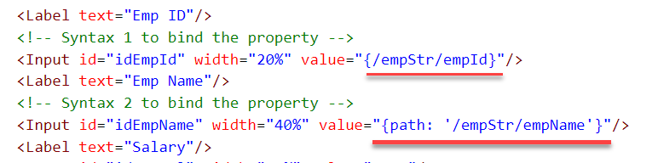
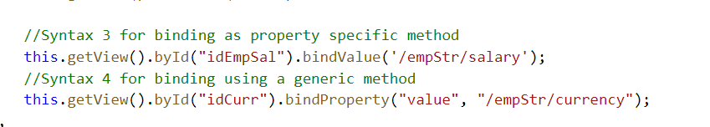
Hands – on: Binding Syntax
Now we will see the different syntax of binding the properties in the View.
Along with that we will see how to align the label and fields in the SimpleForm control.
Code Links:-
Main.view.xml
Main.controller.js
Index.html

Slide 14

Types of Binding
SAP UI5 have 4 types of Binding options:
Property Binding
Expression Binding
Aggregation Binding
Element Binding
Property Binding:-
When we bind property of a UI control, to the address/path of the model, this is called property binding. E.g., value property of Input control was connected to /emp/empId
All the four syntaxes we studied in previous slide are the example of property binding.
Ex:-
In XML view:-
<Text text=“{/emp/empId}” ></Text>
In controller: -
this.getView().byId(“controlId”).bindProperty(“text”, ‘/emp/empId’);

Slide 15
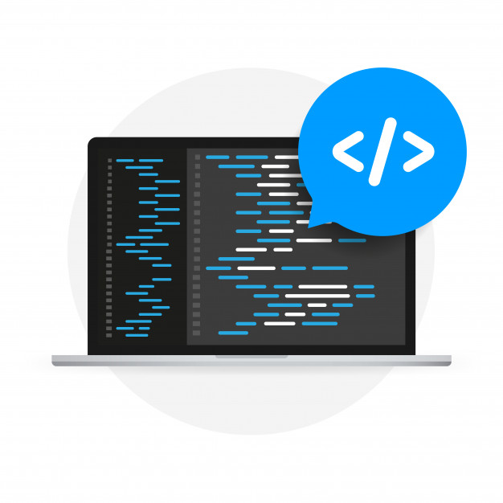
Expression Binding
Expression binding : - When we bind an Expression ({= condition ? true : false}) with the property of a control rather binding value to a property, this is called expression binding.
If we need some calculation on model data or some sort of comparison, then expression binding is useful.
Syntax:
numberState = “{= ${path} > value ? ‘conditionForTrue’ : ‘ConditionForFalse’ }”
Use Case of Expression Binding
My Manager want to add a make salary field grayed(read-only) whenever the employee name is Anubhav.
If The Employee Name is Anubhav, the salary must be 20000.
Condition – if employee name = Anubhav
Outcome – the salary must be 20000
Target – Salary field

Slide 16
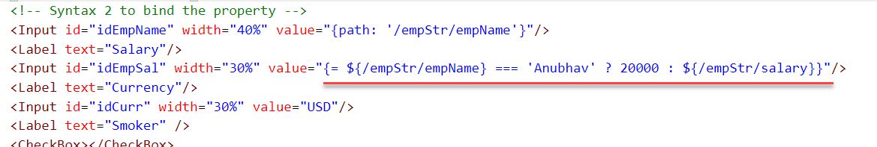
Hands – on: Expression Binding
Now we will bind the Salary field in the SimpleForm with the help of Expression binding Syntax according to the use case mentioned in the previous slide.
Before that we have to comment the line in the controller in which we are binding it form model.
Code Link:-
Main.view.xml
Main.controller.js

Slide 17
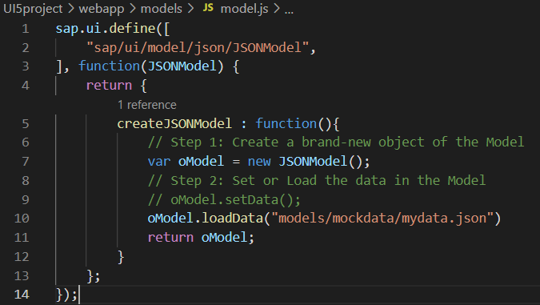
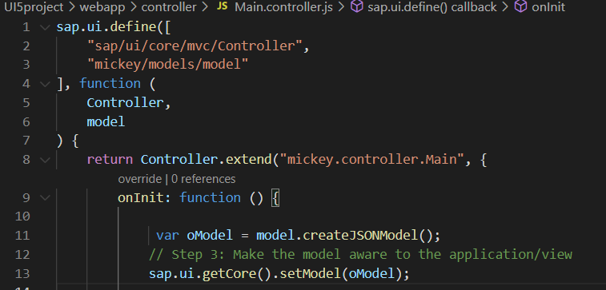
Modularization of Model
1. Create a folder in webapp with name models.
2. Inside models create a file name model.js and then create the function named createJSONModel: function(){}
3. Now create a folder inside the models named mockdata and then inside mockdata create a file named mydata.json
4. Inside the mydata.json put all the data in JSON format.
5. Then inside the models.js :-
6. Then call the model.js inside the controller and create the object then by using the object call the function of model.js
Loading the data from mydata.json using loadData() function
Call the model.js into the controller as dependency.
Object of the model.js
Call the createJSONModel function using the object

Slide 18
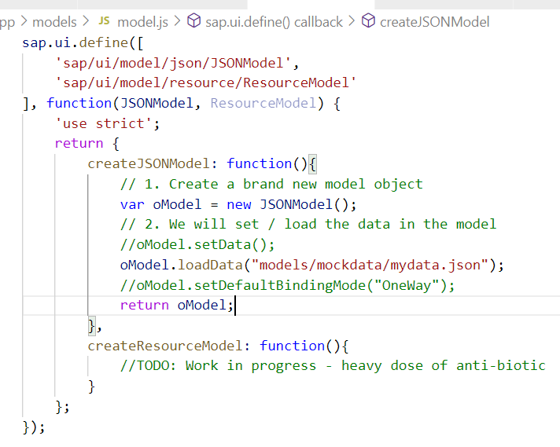
Hands – on: Modularize the Code
Now modularize our model code using the steps shown in the previous slide.
We will also see how to load the data form the model.
Code Links:-
Main.controller.js
model.js
mydata.json

Slide 19
Binding Modes
There are basically three modes of binding data in SAPUI5.
One-way binding – Here, the data is transported in one direction only, i.e., from the model, through the binding instance to the consumer (usually the property of a control), but never in the other direction. Any change done on the model data from the front end is not affected to the model. All the data changes are reflected only on the controls.
Two-way binding – Here all input changes done from front end controls are reflected on the model and the backend database. SAPUI5 automatically handles the transport of data both from the model to the controls and back from the controls to the model. It is the default binding mode.
One-time binding – Here all data will be bound from model to view just once. After that, the connection is no more set.
Data
Data
Model
View
Model
View
Data
One-way binding
Two-way binding
Data
Data
Data
Model
View
Model
View
One-Time binding

Slide 20
Concept of Named Model
Concept of named model comes into observation when we want to use more than one model simultaneously in one application. When we uses two model simultaneously the there are some conflicts arises in the application , as the second model we use will overwrite the data of the first model. So, here we use the Named Model
Creation of Named Model :
this.getView().setModel(oModel2 , “Name of the model”) ;
For example :
this.getView().setModel(oModel2 , “thanos”); → here thanos is the name of the model
Binding using the Named Model:
So in binding we use this name, to bind the data from the named model we use modelName>path in binding syntax
For example:
“{thanos>/empStr/empName}” this will bind the name from thanos model.

Slide 21
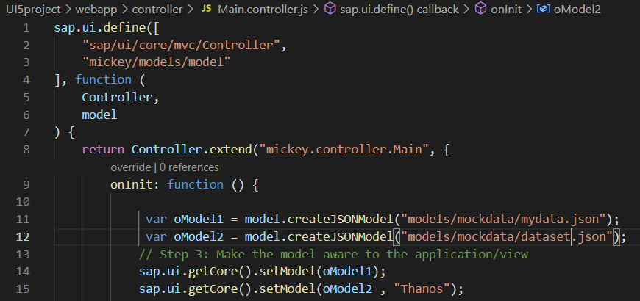
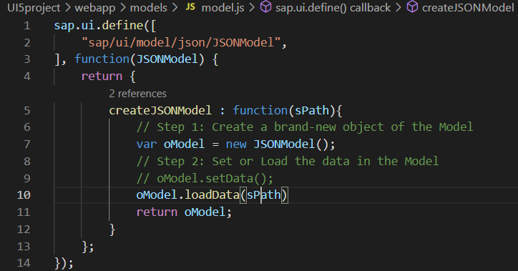
How to create a Named Model
Create a model (dataset.json) in the models folder .
In controller , we have to give the path in the createJSONModel() function
In model.js we have to pass the path as a parameter to create the model with different paths form the same function.
To bind the data in view , we have to use the name of the named model.

Slide 22
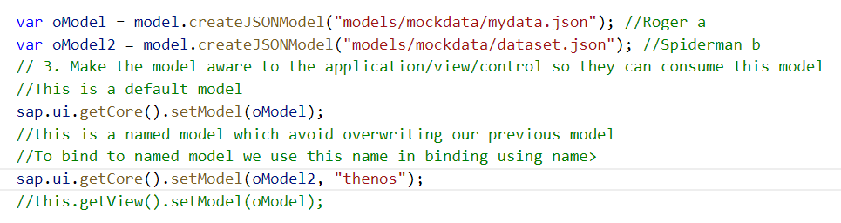
Hands-on : Creation of named model
Now we will see the concept of named model.
Code Links:-
Main.view.xml
Main.controller.js
model.js
dataset.json

Slide 23
Aggregation Binding with Table Control
When we bind the aggregation of a control with the entityset of data model, it is called aggregation Binding.
The parent control (e.g. Table) is bound to the EntitySet path which is called absolute path and the child of the parent Control (e.g. Columns) are connected to the child properties of the EntitySet is called relative path.
In aggregation binding, based on your model data, as many child controls will be created automatically.
Every Event of UI5 will trigger the eventHandler and we will get the Event Object as part of the event Handler. Depending on the event, the event handler object will have different parameters.
Use Case of Aggregation Binding
If we want to show a list or some data in tabular format, we need to bind a group of data. In such a case we will use aggregation binding.
Absolute path
{
“empTab”: [
{
“empId”: 50,
“empName”: “Jay”,
“salary”: 9500
}
]
}
Table = {/empTab}
Emp Id | Emp Name | Salary
{empId} | {empName} | {salary}
Relative Paths

Slide 24
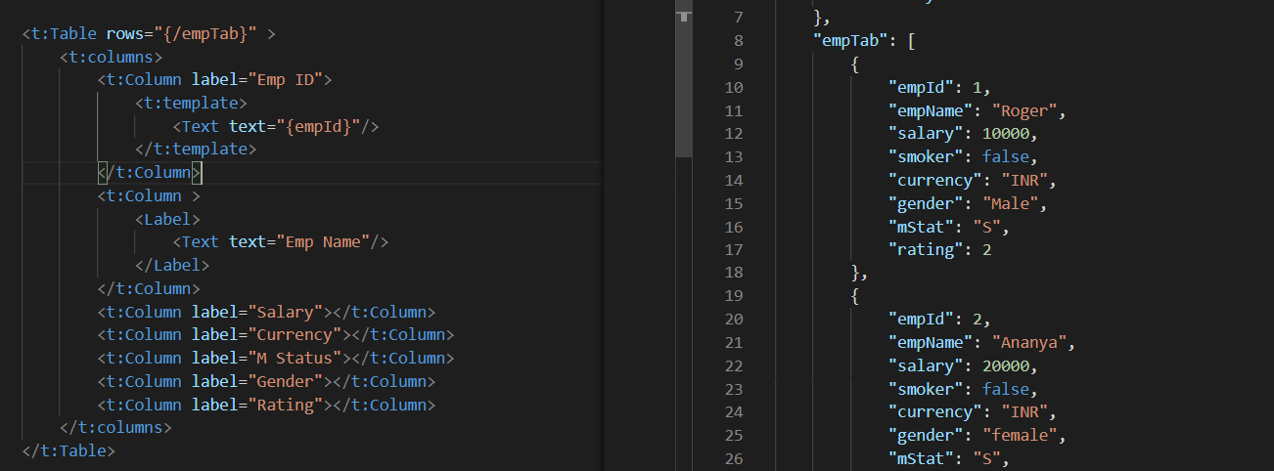
Absolute Path : Connecting parent to parent
Relative Path : connecting child to child respective to parent control

Slide 25
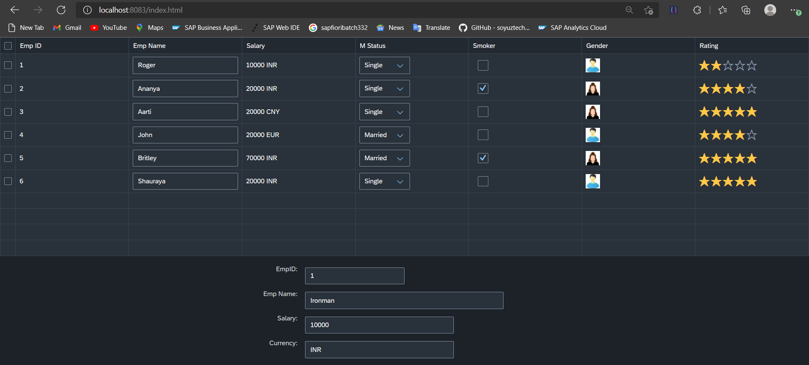
Hands – on: Aggregation Binding & Table
Now we will see how the Aggregation binding works with the help of the table control in SAP UI5.
Documentation of Table control:- https://sapui5.hana.ondemand.com/#/api/sap.ui.table.Table
Code Link:
mydata.json
Main.view.xml

Slide 26
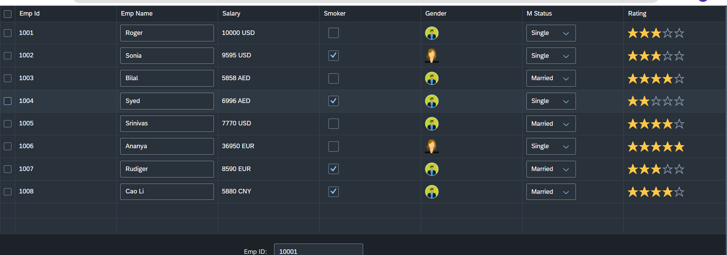
Hands – on: Table with Different Controls
Now we will add different type of controls to the UI table, like Input field, Image, Select, Rating Indicator, Check Box etc.
Code Links:-
Main.view.xml
mydata.json

Slide 27

End of Day 4

Slide 28

Questions

Slide 29

Anubhav Oberoy

Slide 30


We’re committed to empower you to be
Most Desirable Resource
through powerful training solutions.
We build the workforce of the future.
250+
Corporate Clients
30,000+
Learners Trained
25000+
Learners Placed
FREE WEBINARS
Sign up for free webinars with industry experts every fortnight!
Enroll Now!
Contact us today!
https://anubhavtrainings.com/

Slide 31




More from AnubhavTrainings.com

Slide 32
Title
Content

